Slide 1


Introduction to Cloud Computing with R in Google Cloud and Amazon Web Services Session 1: introduction to cloud computing
Sounak Chakraborty
Associate Professor, Department of Statistics
http://faculty.missouri.edu/chakrabortys/

Slide 2
what will we learn from this session
What is cloud computing
What are the advantages and disadvantages
How to conceptualize cloud computing from desktop computing
Major players of cloud computing: aws and gcp
Advantages of running r in cloud

Slide 3

What is cloud computing
Cloud computing is the delivery of on-demand computing services typically over the internet
That includes servers, storage, databases, networking, software, analytics, and business intelligence
Its designed to be on pay-as-you-go basis

Slide 4
Real-World Examples of Cloud Computing: cloud storage
Dropbox, Onedrive, Box, Gmail, Facebook
The number of cloud storage providers online is growing rapidly. Each competing over the amount of storage they can provide to clients.
Dropbox is the pioneer in streamlined cloud storage allowing users to access files on any device through its application or website with up to 2 gigabyte of free storage.
Google’s email service provider Gmail, on the other hand, provides unlimited storage on the cloud. Gmail has revolutionized the way we send emails and largely responsible for the increased usage of email worldwide.
Facebook is a mix of the two, in that it can store an infinite amount of information, images, and videos on your profile. They can then be easily accessed on multiple devices. Facebook goes a step further with their Messenger app, which allows for profiles to exchange data.
Notes:
Yahoo – used to have to delete messages since you didn’t have sufficient storage – gmail has revolutionized this arena

Slide 5
Real-World Examples of Cloud Computing: in education
Coursera, Blackboard, Canvas, Evernote, Overleaf
Education is increasingly adopting advanced technology because students already are. Through the cloud, allows instructors and students to access teaching and learning software on multiple devices.
Coursera offers a variety of online courses from established universities and instructors through its cloud platform.
Blackboard and canvas provides cloud-based learning software for grades K-12, as well as higher education and government. Its products include services such as Classroom, which provides virtual classroom video conferencing, assignment management, classroom analytics and more. Using the company’s cloud-based software, students and educators can access those tools from any computer, smartphone or tablet.
Evernote lets users take notes on their phones, tablets or computers, then saves everything to the cloud. And because it syncs notes across all devices, there's no need to lug around multiple notebooks. Evernote also lets users save audio files, photos and hyperlinks.
Education-oriented cloud computing is projected to hit $25 billion by 2021.

Slide 6
Real-World Examples of Cloud Computing: in healthcare
Cerner, Dell’s Secure Healthcare Cloud, IBM Cloud
Cloud computing lets nurses, physicians, and administrators share information quickly from anywhere. It also saves on costs by allowing large data files to be shared instantly for maximum convenience. This is a major boost for efficiency.
Ultimately, cloud technology ensures patients receive the best possible care without unnecessary delay. The patient’s condition can also be updated in seconds through remote conferencing.
Clinical applications: EHRs, physician enquiries, pharmacy orders, etc.
Non-clinical: healthcare management applications to handle revenue cycle management, patient billing and claims.
However, many modern hospitals have yet to implement cloud computing but are forecasted to do so in the near future.

Slide 7
Let me be clear and more contextual !!!
Suppose you need to run a computer code you have written. It involves lots of calculations/loops and also it needs lots of memory to access/store/swap data.
However you only need to run such code/calculation may be once a month. Each time you run it takes 1 hr to complete the task on a computer which has 24 GB ram and intel core i9 4.6 gz processor.
You can buy such machine for $5000 for yourself and then use only for 12 hr in a year.
The computer value will depreciate, it may breakdown needing expensive repair and maintenance, to run the machine there is electricity cost.
Suppose in the middle of the year you revise your computer code based on additional data which makes your model better but due to increased size of the data you need 50 gb ram. Will you buy a new machine ?

Slide 8

Cloud is your friends with benefit
Use (rent) the service (computer) from cloud (your friend) without any large financial and loyalty commitment.
Pay for only the time you use. Here you only pay for 12 hrs of real use in a year.
If your need changes or you are unhappy you can switch to any other type/more powerful of machine or service provider.
No need to worry about the computer maintenance, utility bills etc.

Slide 9

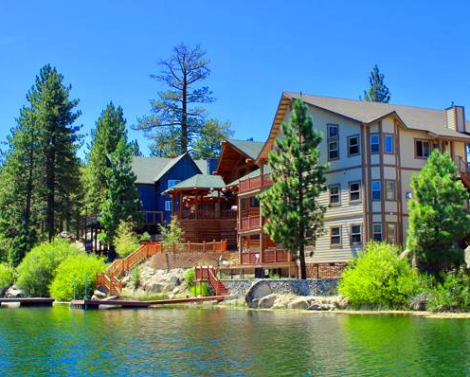

Is the idea of cloud computing relatable ?
Fancy car, boat, lakefront property: use only 2 weeks a year. Buy vs rent ?

Slide 10
A brief history of cloud computing
1960 era of mainframes: when computer bureaus would allow companies to rent time on a mainframe, rather than have to buy one themselves.
1970 concept of virtual machines (VMs): Using virtualization software like VMware, it became possible to execute one or more operating systems simultaneously in an isolated environment. Complete computers (virtual) could be executed inside one physical hardware which in turn can run a completely different operating system.
1980 Rise of pc: The “time-sharing” services were largely overtaken by the rise of the PC which made owning a computer much more affordable, and then in turn by the rise of corporate data centers where companies would store vast amounts of data.
But the concept of renting access to computing power has resurfaced again and again -- in the application service providers, utility computing, and grid computing/parallelization of the late 1990s and early 2000s. This was followed by cloud computing, which really took hold with the emergence of software as a service and hyperscale cloud computing providers such as Amazon, Google, and Microsoft.

Slide 11
Benefits of cloud computing
Cost: Eliminates the capital expense of buying hardware and software. the round-the-clock electricity for power and cooling, and the IT experts for managing the infrastructure.
Speed: Vast amounts of computing resources can be provisioned in minutes, typically with just a few mouse clicks with out any capacity planning.
Scale: ability to scale elastically. for example, more or less computing power, storage, bandwidth—right when they’re needed,
Productivity: No need for hardware setup, software patching, and other time-consuming IT management chores. You can spend time on achieving your more important primary goals.
Performance: regularly upgraded to the latest generation of fast and efficient computing hardware.
Reliability: data can be mirrored at multiple redundant sites on the cloud provider’s network so recovery from a breakdown is relatively easy.
Security: cloud providers offer a broad set of policies, technologies, and controls that protect your data, apps, and infrastructure from potential threats.

Slide 12
Cloud computing disadvantages
Cloud computing is not necessarily cheaper than other forms of computing, just as renting is not always cheaper than buying in the long term. If an application has a regular and predictable requirement for computing services it may be more economical to provide that service in-house.
You may be reluctant to host sensitive data in a service that is also used by others/rivals.
While it may be easy to start using a new cloud application, migrating existing data or apps to the cloud may be much more complicated and expensive. And it seems there is now something of a shortage in cloud skills. Your chance to shine ?
And of course, you can only access your applications/codes if you have an (fast) internet connection.

Slide 13
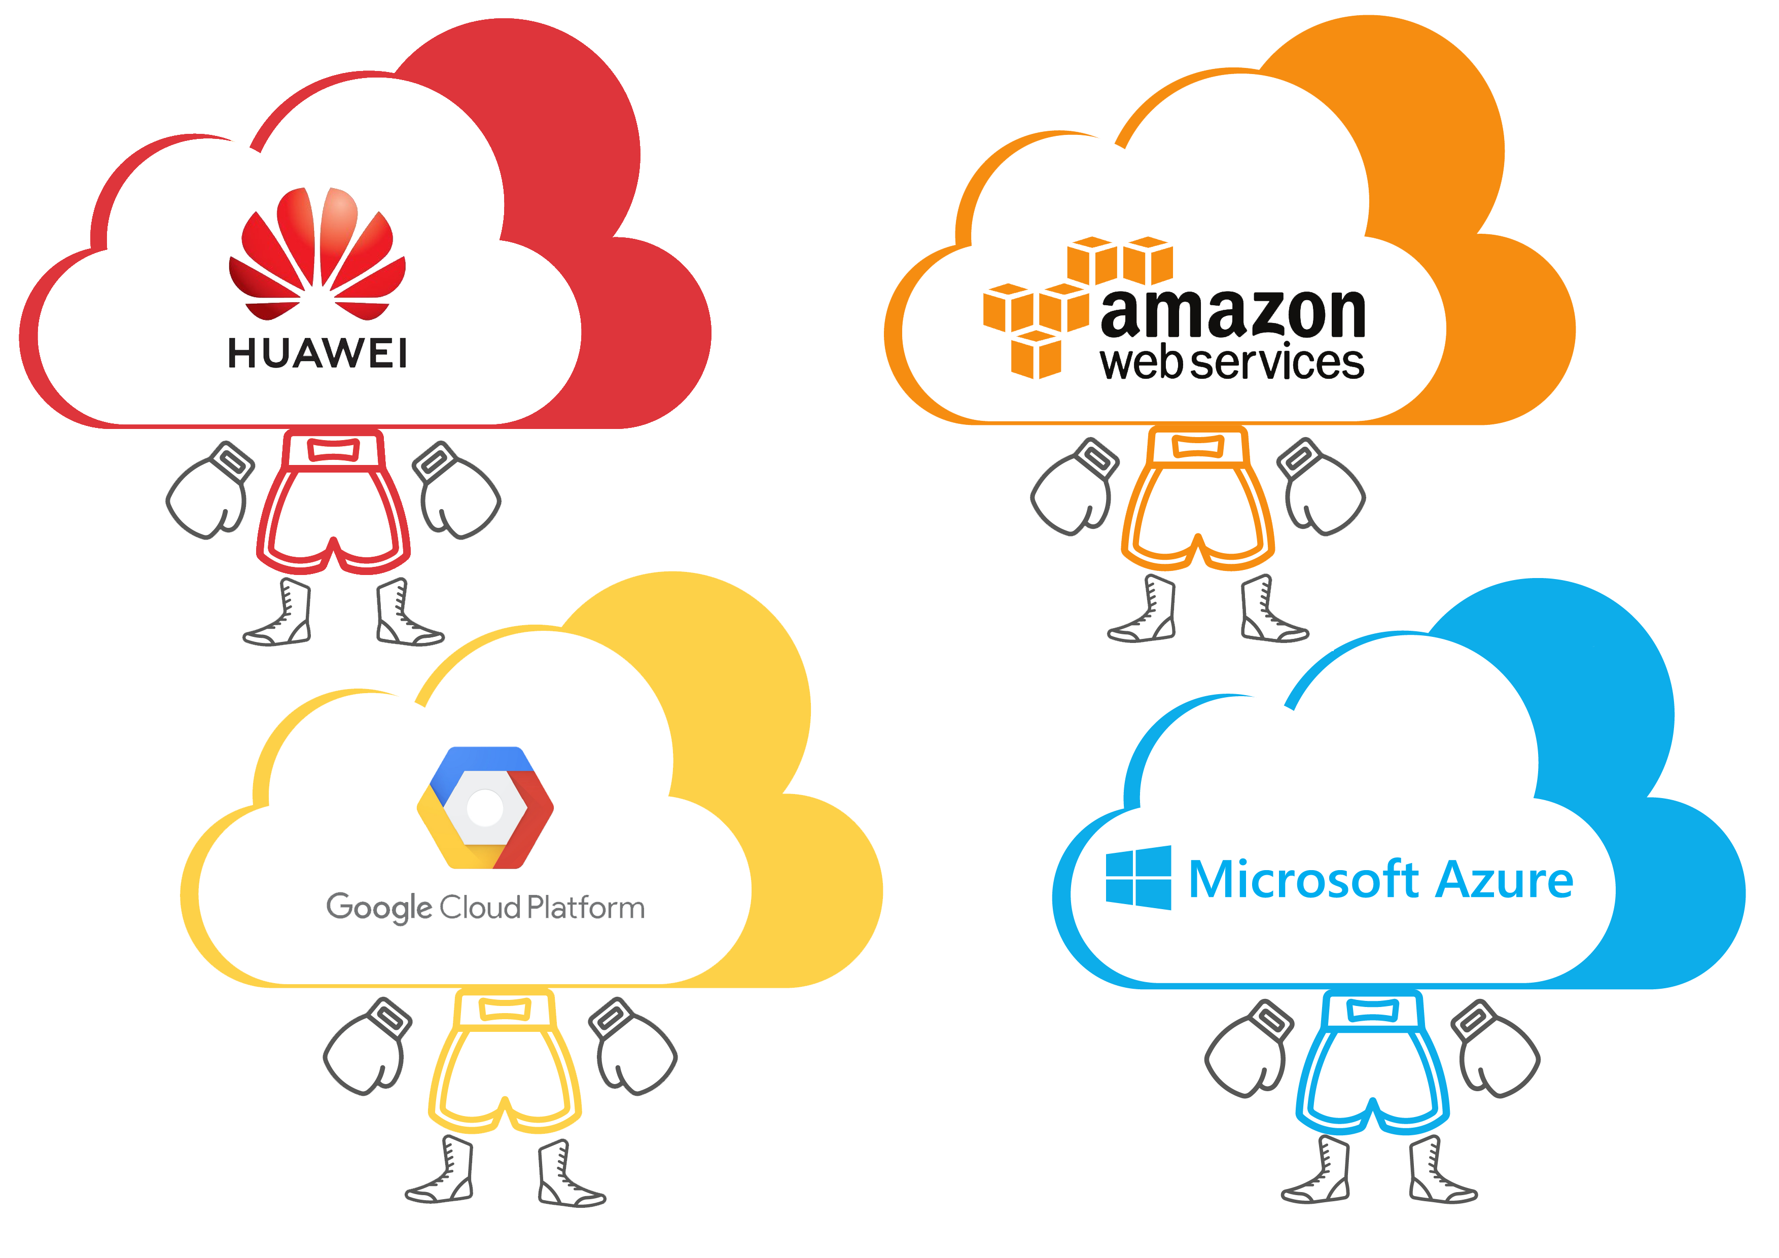
Major players in cloud services

Slide 14
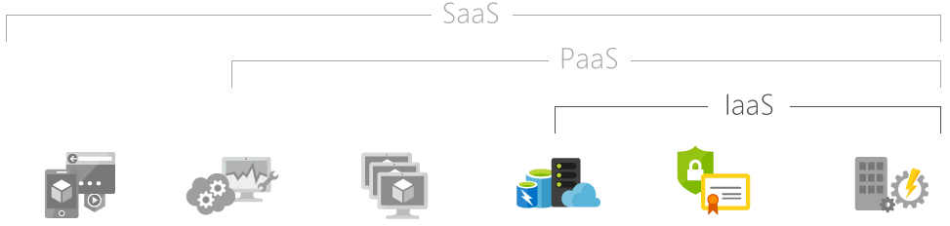
Types of cloud computing services
Hosted applications/apps | Development tools, database management, business analytics | Operating systems | Servers and storage | Networking firewalls/security | Data center physical plant/building
Infrastructure as a service (IaaS)
The most basic category of cloud computing services. With IaaS, you rent IT infrastructure—servers and virtual machines (VMs), storage, networks, operating systems—from a cloud provider on a pay-as-you-go basis.
Notes:
Examples – Amazon Web Services, Microsoft Azure, Google Compute Engine which you use to run code,
mostly focus on this in this lecture

Slide 15
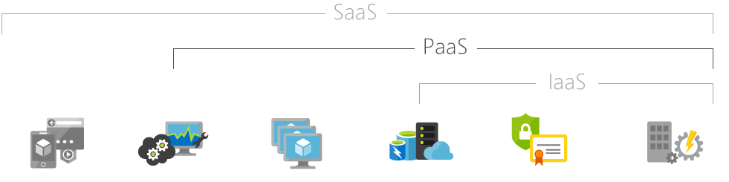
Types of cloud computing services
Hosted applications/apps | Development tools, database management, business analytics | Operating systems | Servers and storage | Networking firewalls/security | Data center physical plant/building
Platform as a service (PaaS)
Platform as a service refers to cloud computing services that supply an on-demand environment for developing, testing, delivering, and managing software applications. PaaS is designed to make it easier for developers to quickly create web or mobile apps, without worrying about setting up or managing the underlying infrastructure of servers, storage, network, and databases needed for development.
Notes:
Google App Engine

Slide 16
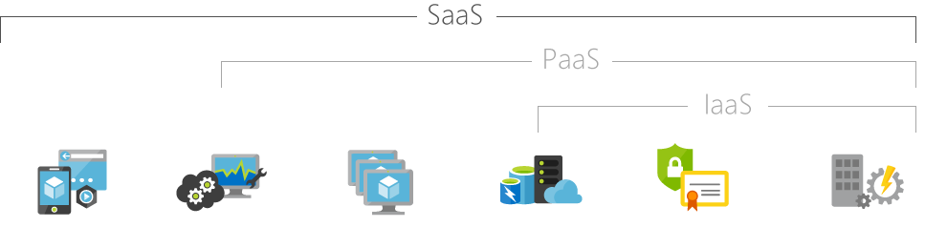
Types of cloud computing services
Hosted applications/apps | Development tools, database management, business analytics | Operating systems | Servers and storage | Networking firewalls/security | Data center physical plant/building
Software as a service (SaaS)
Software as a service is a method for delivering software applications over the Internet, on demand and typically on a subscription basis. With SaaS, cloud providers host and manage the software application and underlying infrastructure, and handle any maintenance, like software upgrades and security patching. Users connect to the application over the Internet, usually with a web browser on their phone, tablet, or PC.
Notes:
Cisco WebEx, DropBox, Zoom

Slide 17
Security issues in cloud computing
We may remain concerned about the security of cloud services. breaches of security are rare but happens.
How secure you consider cloud computing to be will largely depend on how secure your existing systems are. In-house systems managed by a team with many other things to worry about are likely to be leakier than systems monitored by a cloud provider’s engineers dedicated to protecting that infrastructure.
The main security breach happens when moving data between many cloud services.
There is growth in cloud security tools, which monitor data moving to and from the cloud and between cloud platforms. These tools can identify fraudulent use of data in the cloud, unauthorized downloads, and malware. There is a financial and performance impact however: these tools can reduce the return on investment of the cloud by five to 10% , and impact performance by five to 15% .
The country of origin of cloud services is also worrying some organizations.

Slide 18
A B C of cloud computing
Irrespective of what type of code or application you run below is a general step by step process
Step 1: you pick a cloud service provider
Step 2: you create/chose a “virtual machine” for your designated project in the cloud. This is the fun part where you can choose the operating system, machine architecture etc.
Step 3: you install the packages required to run your codes in your designed virtual machine.
Step 4: submit your codes/jobs in the designated machine
Notes:
Does not matter what type of code, service, platform you use → you will follow this pattern

Slide 19
A sample cost analysis of running jobs in cloud
I picked google cloud
I create a “virtual machine” for my project which has 16 gb ram and intel i9 4.6 gz processor. On average the fee is $0.02-$0.04/hr.
If I run 10 hr/week my monthly cost will be $0.80 - $1.60.
If you run your desktop for 40 hrs just your monthly utility bill will be much more than that.

Slide 20
Cloud Computing using R Programming
Simply put, it means running or submitting your r codes/jobs on a computer rented from cloud and pay for only the time used to run your code.
R is free. Python is free just like R, but the main reason R scores is that the statistical library of R packages is far more extensive. SAS remains the leading language for corporate analytics on the desktop, but it remains expensive for individual users.
Notes:
Submit code not on my computer but on rented computer

Slide 21
What are the advantages of using R on the cloud versus on the desktop?
Since we know R is constrained to handle data only as big as the RAM size, the cloud offers us a quick solution to handle Big Data Science using R. This can be done by simply ramping up the RAM on the virtual machine instance. You can see the various kinds of RAM options available on the cloud which are simply not affordable on the local machine.
For big Datasets , it is better to use it on the cloud than to download the dataset, process it and then score it. For example, if you have a competition that uses 30 GB of data, it is best you use it on the cloud. The cloud is thus a great way of learning about Big Data without getting hassled by internet speed.
Cloud has much better bandwidth speed. Therefore, installing software and transferring data is much faster on the cloud.
You can use additional services like AzureML with R on the cloud rather than build your own machine learning service from scratch
Cloud is much more scalable for changes in volume or velocity of data.

Slide 22
What is google cloud platform (gcp)
Google Cloud Platform is a suite of public cloud computing services offered by Google.
The platform includes a range of hosted services for compute, storage and application development that run on Google hardware.
Google Cloud Platform services can be accessed by software developers, cloud administrators and other enterprise IT professionals over the public internet or through a dedicated network connection.
Notes:
We will use the Compute and Storage service

Slide 23
Google Cloud Platform offerings
Google Compute Engine, which is an infrastructure-as-a-service (IaaS) offering that provides users with virtual machine instances for workload hosting.
Google App Engine, which is a platform-as-a-service (PaaS) offering that gives software/model developers access to Google's scalable hosting.
Google Cloud Storage, which is a cloud storage platform designed to store large, unstructured data sets. Google also offers database storage options.
For artificial intelligence (AI), Google offers its Cloud Machine Learning Engine, a managed service that enables users to build and train machine learning models.
For this short course we will mostly focus on google compute engine.

Slide 24
Cost of google cloud platform
Good news: for beginners you get a $300 worth of computing credit for the first 90 days after you create a google compute account.
Bad news: $300 credit expires after the first 90 days. Unused part of the credit simply goes away. Use it or lose it.
Cost of the virtual machines are extremely low. Often less than $.01/hr.
You have wide choices of operating system, ram, cpu, gpu, multiprocessors to play with. Its like a high-end shopping mall but lowest possible prices.

Slide 25
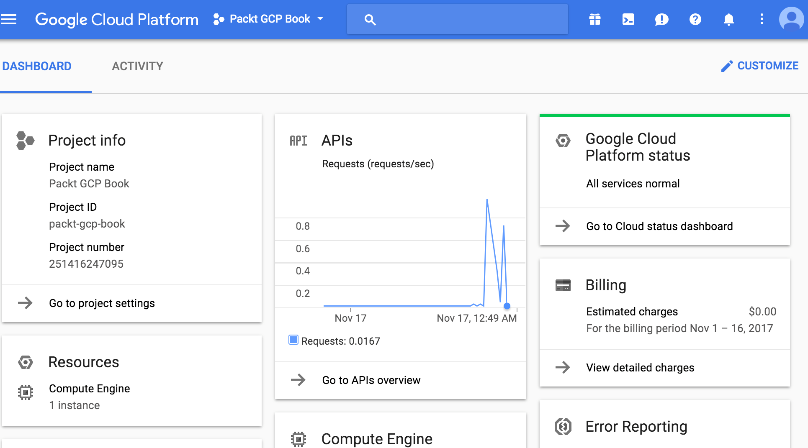
Google compute console

Slide 26
What is amazon web services (aws)
AWS is a comprehensive, easy to use computing platform offered by Amazon.
The platform is developed with a combination of infrastructure as a service (IaaS), platform as a service (PaaS) and packaged software as a service (SaaS) offerings.
History of aws
2002- AWS services launched
2006- Launched its cloud products
2012- Holds first customer event
2015- Reveals revenues achieved of $4.6 billion
2016- Surpassed $10 billon revenue target
2016- Release snowball and snowmobile
2019- Offers nearly 100 cloud services

Slide 27
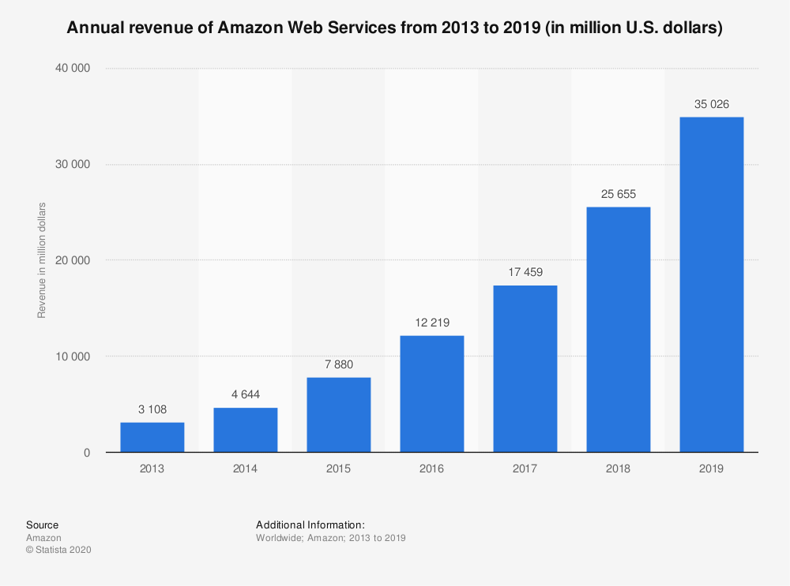
Amazon compute services
EC2(Elastic Compute Cloud): EC2 is a virtual machine in the cloud on which you have OS level control. You can run this cloud server whenever you want.
AWS Lambda: This AWS service allows you to run functions in the cloud. The tool is a big cost saver for you as you to pay only when your functions execute.

Slide 28
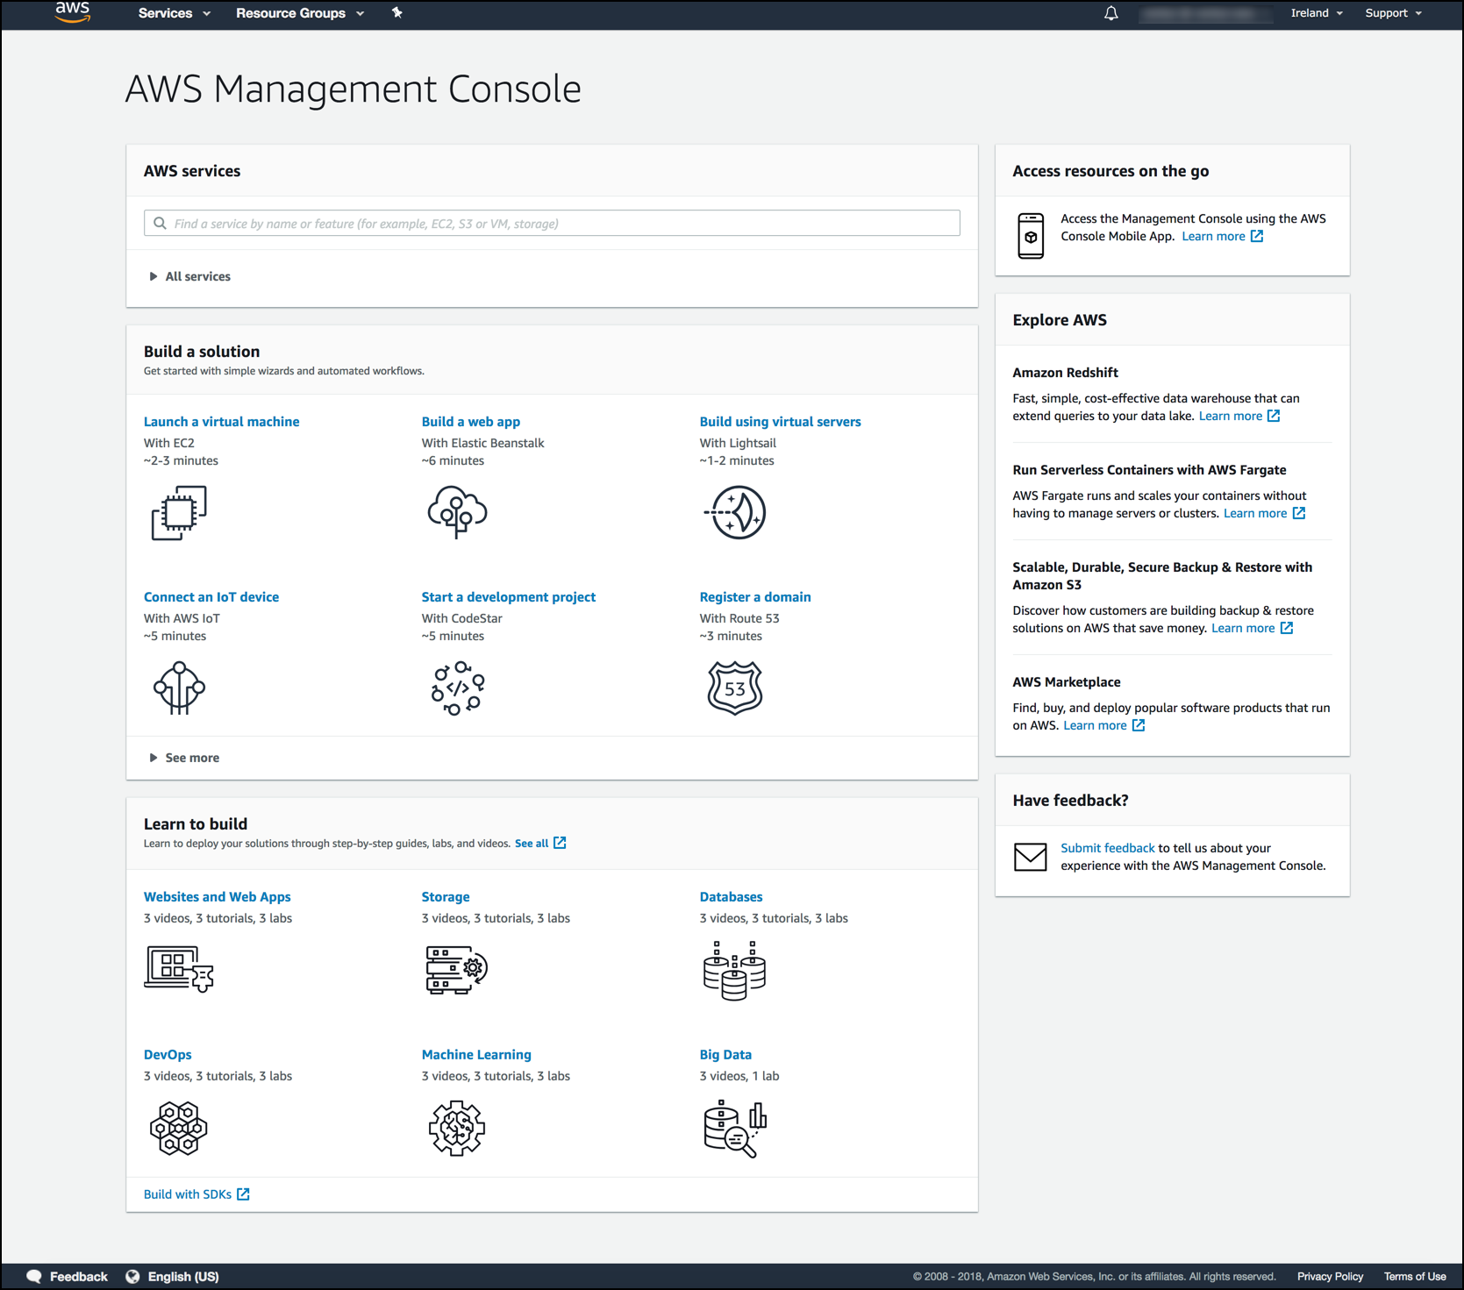
Aws ec2 console

Slide 29
Aws vs gc
Parameters | AWS | Google Cloud
Age | 11 years | 6 years
Pricing | Per hour basis | Per-minute basis
What is? | AWS is a secure, cloud service the platform developed and managed by Amazon. | Google Cloud Platform is a suite ofGoogle's public cloud computingresources and services.
Best feature | It dominates the public cloud market by offering a range of cloud-based products and services. | It specializes in high compute offerings like Big Data but is fairly new to the cloud scene.
Main service | The flagship compute service of AWSis Elastic Compute Cloud, or EC2. | Google's primary service is Compute Engine.
Cost | It's on a little higher end in terms of compute and storage costs. | It's a clear winner with its competitive pricing as compared to AWS.
File storage | Amazon Elastic File System (Amazon EFS) | Cloud Filestore
Backup | Amazon S3 is used for secondary backup storage | Has its own built-in Google Cloud
Serverless computing | AWS Lamba | Container Engine
Volume Sizes | 500GB to 16TB | 1 GB to 64 TB
AI service and Machine Learning | AWS has its own Al service, called SageMaker. Compared to Google, the AI offering of AWS is limited. | Google cloud used AI chips called TPU which can run TensorFlow and other AI Libraries. The speed and performance is quite faster compares to other similar services.
Data transmission format | In general format. | In a fully encrypted format.
Big data support | AWS has its own big data analysis tool which is called AWSLambda. | Google Cloud Platform has its AI known as AI Firstfor data management for its servers.

Slide 30
So what did we learn from this session
What is cloud computing
What are the advantages and disadvantages
How to conceptualize cloud computing from desktop computing
Major players of cloud computing: aws and gcp
Advantages of running r in cloud

Slide 31
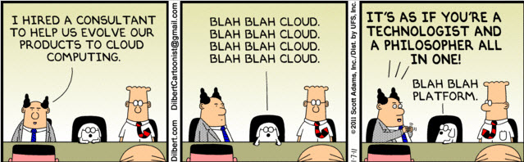
THANK YOU SOUNAK CHAKRABORTY CHAKRABORTYS@MISSOURI.EDU http://faculty.missouri.edu/chakrabortys/

